Slide 1
Week 8
14 / 07 / 2026
Binary indexes · nonexistent-index experiments · when to split or pad · ACK delay

Slide 2
Pick up from last week
• Last week: one SELECT / OPERATE can carry many CROBs. Nmax = 16.
• At 17 CROBs, the 17th (index 16) is rejected with TOO_MANY_OPS, so no OPERATE is sent.
• Dr. Lin asked two things:
• Is "too many operations" the same as "that index does not exist"?
• Can a nonexistent index be slipped in as harmless padding?
This week
• Binary indexes — what they are.
• Moved a nonexistent index around and read the errors.
• When do we split, and when do we pad?
• ACK delay — what we are thinking.

Slide 3
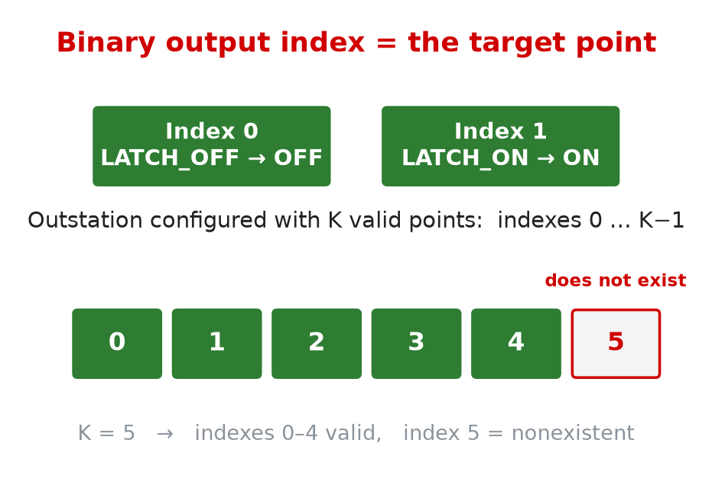
Binary indexes
What it clarified
• The index is the output point a CROB targets.
• We simulate two binary output points: index 0 and index 1.
• Valid indexes run 0 to K−1. Anything K or higher does not exist.
How I used it
• Configure K valid points, then ask for one extra (index K) to find the edge.
• Read the per-index status from the PCAP, not from the API.

Slide 4
Experiments — moving the nonexistent index
Case | Ordered CROBs (K = 5 valid) | What we test
End | 0, 1, 2, 3, 4, 5 | fake index last
Begin | 5, 0, 1, 2, 3, 4 | fake index first
Middle | 0, 1, 5, 2, 3, 4 | fake index in the middle
Multiple | 0, 1, 2, 3, 4, 5, 6, 7 | several fake indexes
Decoy only | 5, 6, 7 | all indexes fake
Fake + limit | K=5, 17 CROBs | fake AND over the count limit
Over limit | K=16, 17 CROBs | all valid, one too many
one command, ordered CROBs:
run_master.py --action multi-crob-sbo \
--crob-plan "0:LATCH_ON,1:LATCH_ON,
2:LATCH_ON,3:LATCH_ON,
4:LATCH_ON,5:LATCH_ON"
• Group 12 Var 1 CROBs only.
• Software points only. No physical device.
• Correctness = per-index status, not packet count.

Slide 5
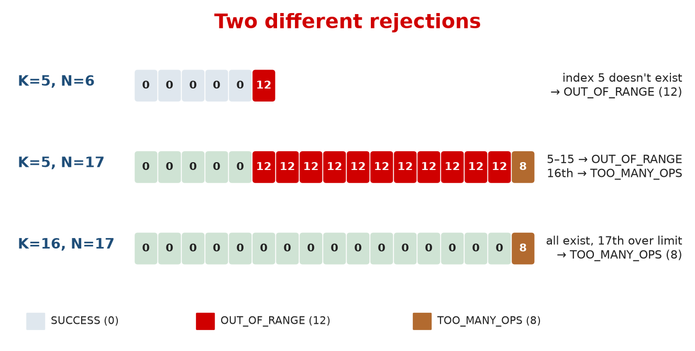
Two different rejections
• A nonexistent index → OUT_OF_RANGE (status 12).
• Too many operations → TOO_MANY_OPS (status 8).
• Different codes, and both show up per index on the wire.
• K=5, N=17 shows both at once: 0–4 ok, 5–15 OUT_OF_RANGE, 17th over the limit.
# analyze_multicrob_pcap.py
STATUS_NAMES = {0: 'SUCCESS',
8: 'TOO_MANY_OPS',
12: 'OUT_OF_RANGE'}

Slide 6
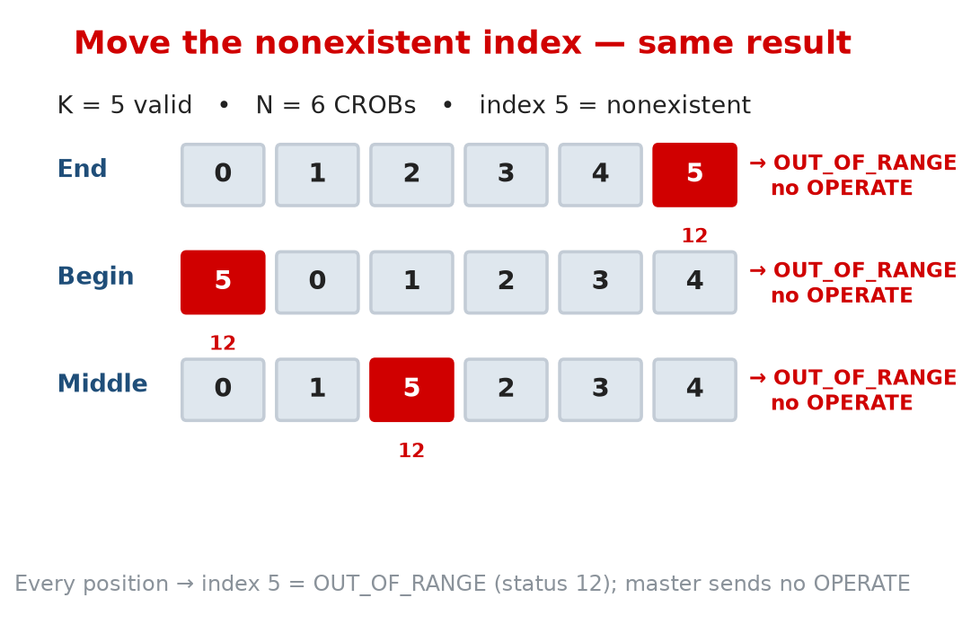
Where we put the fake index doesn't matter
• Fake index at the start, middle, or end — same result.
• That index comes back OUT_OF_RANGE (12), wherever it sits.
• The SELECT only partly succeeds, so the master sends no OPERATE.
• No valid output changes. The whole control is blocked.

Slide 7
Can a nonexistent index be padding? No.
• The fake index is rejected and is visible on the wire (OUT_OF_RANGE).
• One bad index blocks the whole OPERATE.
• So we can't slip fake indexes into a real control to pad its size.
To be clear: this does not prove padding is impossible. It shows one obvious way (fake indexes) does not work, and points us where to look next.

Slide 8
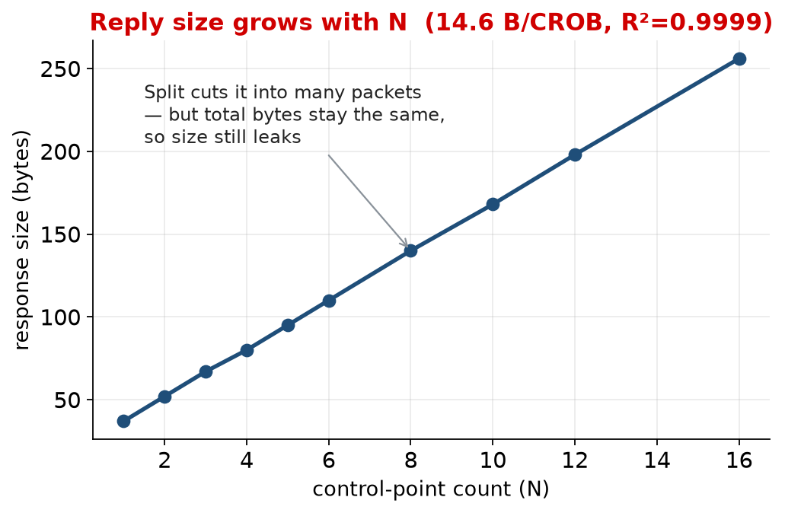
So — when do we split, and when do we pad?
Split
• Cut one reply into many small packets.
• Good for big reads — hides the packet shape.
• But total bytes stay the same, so it does not hide size.
Pad
• Make a small reply look bigger — the only thing that hides size.
• No safe way inside DNP3 today (the fake-index test is one dead end).
• Real padding = a future encrypted-tunnel step.
For now: split the big reads, normalize their timing, and record the size that still leaks.

Slide 9
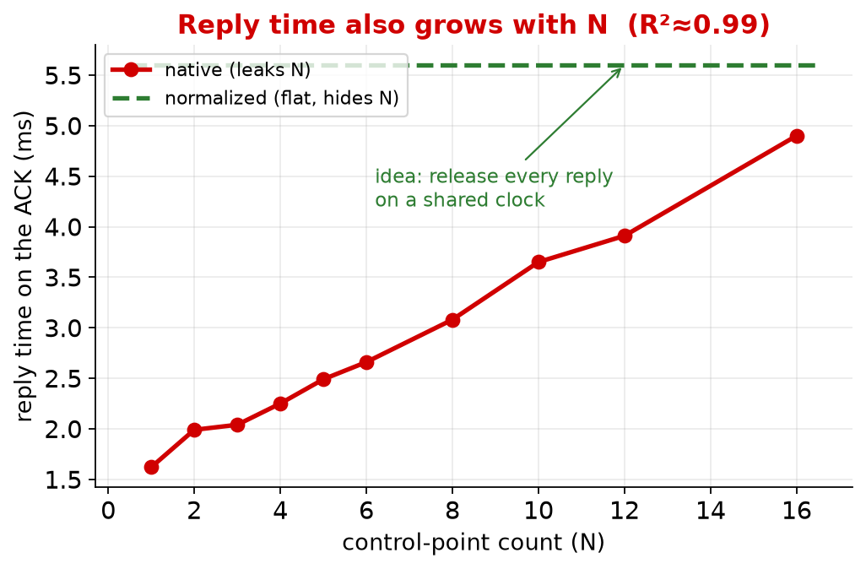
ACK delay — what we are thinking
• The reply rides on the same TCP ACK that answers the request — so ACK time = reply time.
• Reply time grows with N, so it leaks how many points were touched (R²≈0.99).
• Idea: hold each reply to a shared deadline that does not depend on N.
• Random jitter won't do — an attacker averages it out. A shared clock they can't.
• Stay under the TCP retransmit timer. Never delay a control.
# release no earlier than a common deadline
candidate_release = max(
response_ready_time,
request_time + target_delay)

Slide 10
Questions / Next steps
• Does the OUT_OF_RANGE vs TOO_MANY_OPS story match what you expected?
• Next: measure the real retransmit timer on the rig, and repeat the size / timing readings with error bars.
• Then one clean run that splits + normalizes timing, and check nothing breaks.
• Open question: do we open a future encrypted-tunnel line to actually hide size?

